Slide 1

Customer Discovery
WEEK SEVEN
CEO: Rachel Evans
CTO: Sophie Tanker
CFO: Andra Buchan

Slide 2
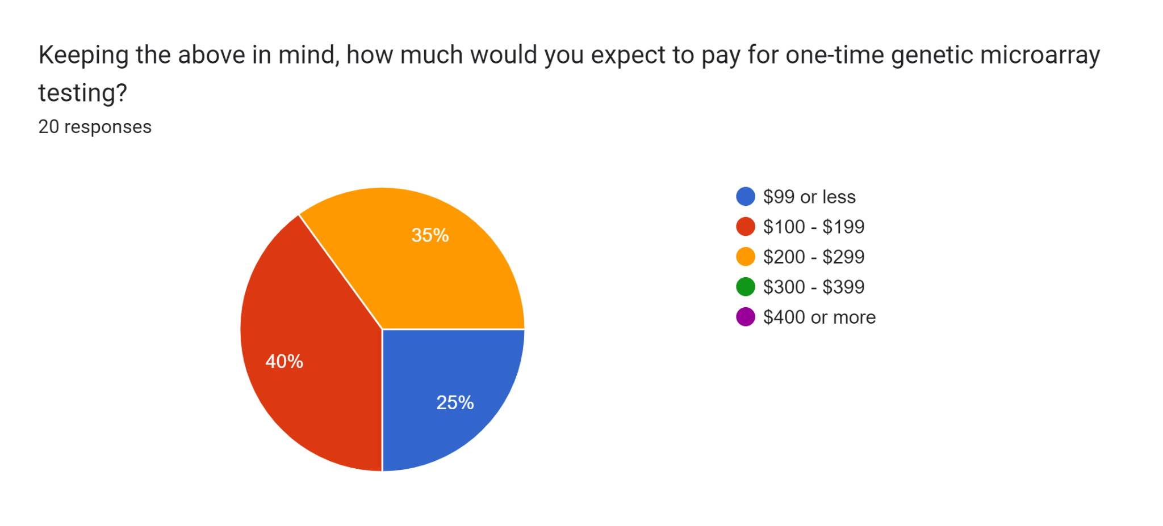
DNA sampling currently on the market exists for a variety of reasons.
These tests are sold starting around $99, but depending on the specifics they can reach prices up to $899. The average price of these direct-to-consumer tests is $313.
(From Week Six)

Slide 3

OUR PRICE STRUCTURE
One-time fee for Genetic Analysis: $250
Monthly Subscription: $50
Payment Plan for One Year: $71 each month

Slide 4
Advertising Discovery

Slide 5

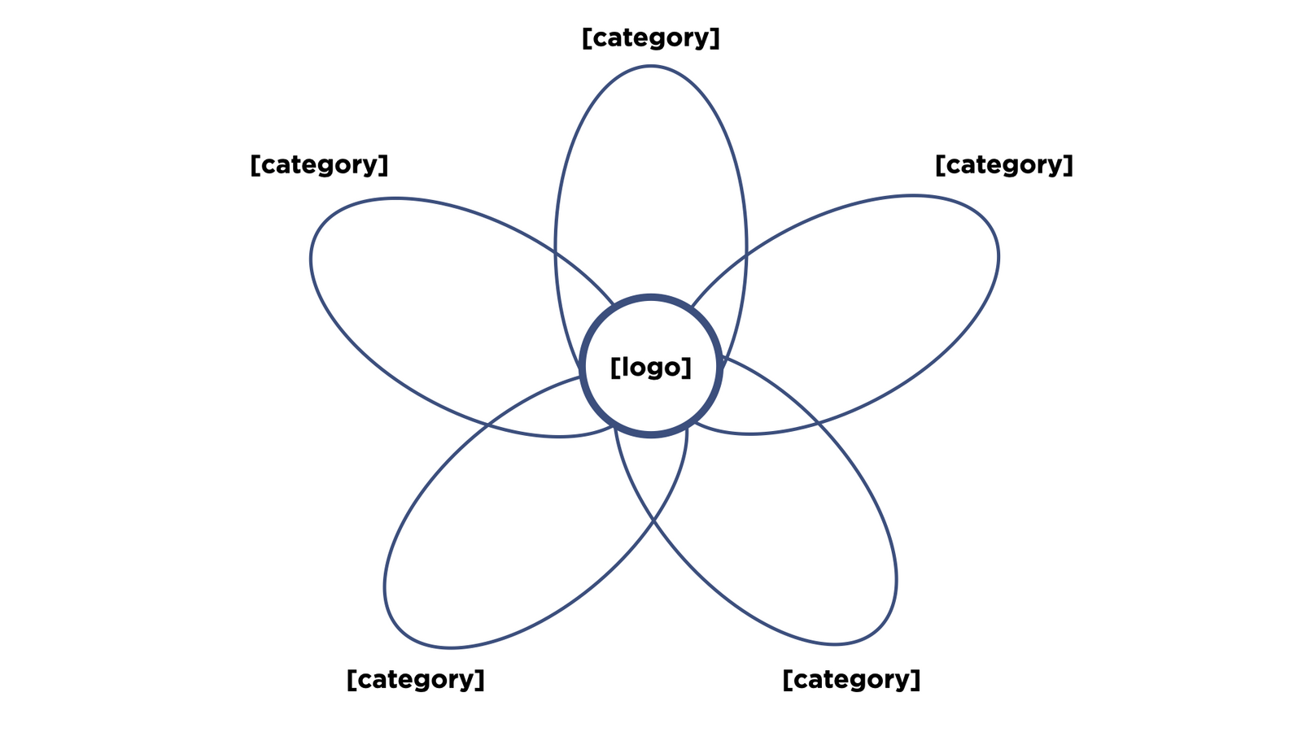

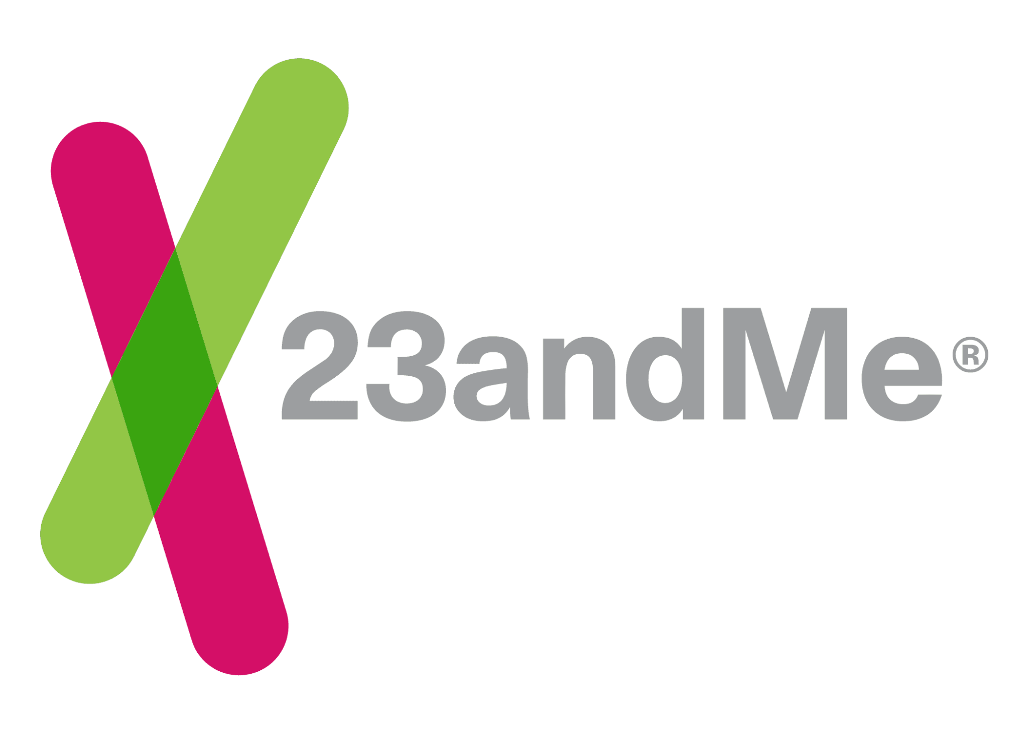










Genetic Health Testing
DNA Sequencing
Custom Supplements
Over-the-Counter Supplements
DNA Sequencing in Healthcare

Slide 6


23andMe

Slide 7


care/of
persona

Slide 8

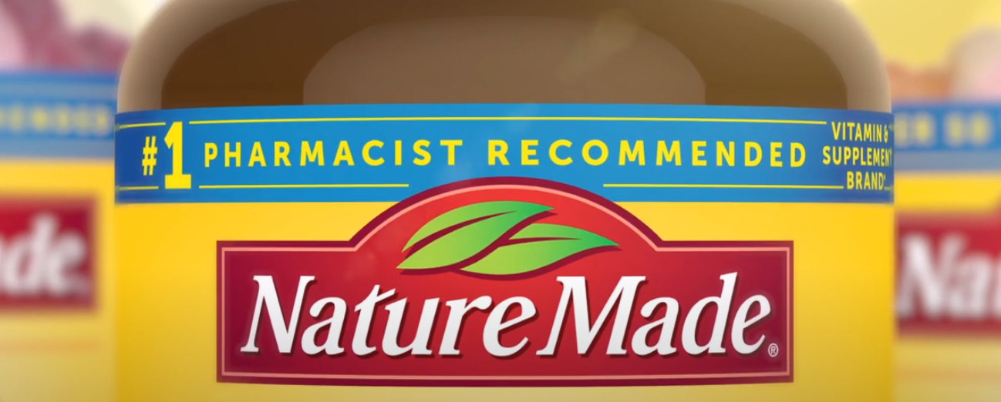
Ritual
NatureMade

Slide 9

Our Advertisement

Slide 10
ADVERTISING SUPPLEMENTS
Minimalist, white backgrounds
Capsule graphics
Smiling people
More frequently women
Simple, neutral clothes
Framed as taking charge of your health
Choose to take the vitamin
Emphasis on the customer being unique

Slide 11
ADVERTISING NICHE
YouTube
Instagram
TikTok
Sponsorships with Creators/Influencers
Other social media
Within pages with ad space
Emails
If you sign-up
If you make a purchase
Coupons/Discounts

Slide 12
Thank You!

